Slide 1

Introduction to Linguistics
Monsoon, 2018
(August 14 – Nov 16 )
Course instructors
Dipti Misra Sharma
Radhika Mamidi
TA : Tanmai Khanna

Slide 2
Linguistics?
The study of human speech including the units, nature, structure, and modification of language
---- Merriam Webster
The scientific study of language and its structure, including the study of grammar, syntax, and phonetics. Specific branches of linguistics include sociolinguistics, dialectology, psycholinguistics, computational linguistics, comparative linguistics, and structural linguistics.
------ Oxford Dictionary
t

Slide 3
What is ‘Language’?
System of Communication that humans use to exchange ideas/thoughts?
Wherever there are human beings, there is, at least, one language.
Every human being knows at least one language.

Slide 4


What do we know when we 'know' a language?
When we say “ I know 'X' language” what is it that I know?
  The sounds?
  The words?
accept, acceptable, unacceptable; live livable unlivable,
  The grammar??
The sea is so calm today. So calm is the sea today.

Slide 5


Language
We don't utter words randomly.
  to on time class come
We know when a sentence is not right.
?The sea is today so calm. *The is sea so calm today. *So calm is today the sea.
We can form new words, new expressions, new sentences
Google, googleable?? ungoogleable???
But some new formations are not allowed and we know that
come, *comable, *uncomable
Sounds, words, sentences are arranged in a particular way for them to be meaningful.
Today, the sea is so calm.
We seem to know all this and more when we know a language.

Slide 6
How do we learn a language?
How come a child is able to speak quite coherently by the time she is two years old?
A child can talk like an adult by the time she is five.
How come children pick up language(s) so early even though they are not taught it formally?
Is it that they acquire it by listening to adults talking around them?
Or
Are they born with it? If they are born with it then it cannot be a 'particular' language.
So, is there some faculty which allows us to acquire a language once we are exposed to it?
What is the cognitive process for the ‘language activity’ ?
What is the relation between language and mind, if any?
What is the relation between language and brain, if any?

Slide 7
What is 'language'?
Is language what we speak or what we write?
What is the relation between language and script?
Like languages there are several scripts in the world.
Are the scripts also related like languages?
How many types of writing systems are there?
Does every language has a writing system?
If not, then language cannot be what we write?
The question 'what is language' remains.
We can talk about things in the future, in the past, about things far away, things near by.

Slide 8
Language is a system : 'needs knowledge'
Several types of knowledge is used for meaningful utterances.
Knowledge of sound system, knowledge of word structures knowledge of sentence structures etc
Knowledge of what to speak to whom and when and how.
Knowledge of world around us
If language is a system which has several types of knowledge, then how is this knowledge organized?
If it has structures, then these must be composed of some parts?
What are those parts?
How can we identify these parts?
How do these parts combine to form the larger structures?
What is the relation between words and their meaning?

Slide 9
Some more questions!!
What is the function of language in our lives?
Do the other living beings also have 'language'?
How is our (human) language different from animal communication?
What does it have in common with animal communication?
If language plays an important role in a social process (communication), then
Is there some relation between language and society?
Apart from knowing the grammar of Hindi, I also know when to use 'aap' and when to use 'tuu'.
What is the relation between language and culture?
There are so many varieties of Hindi, similarly of Telugu, similarly of English, how are these varieties related ?

Slide 10
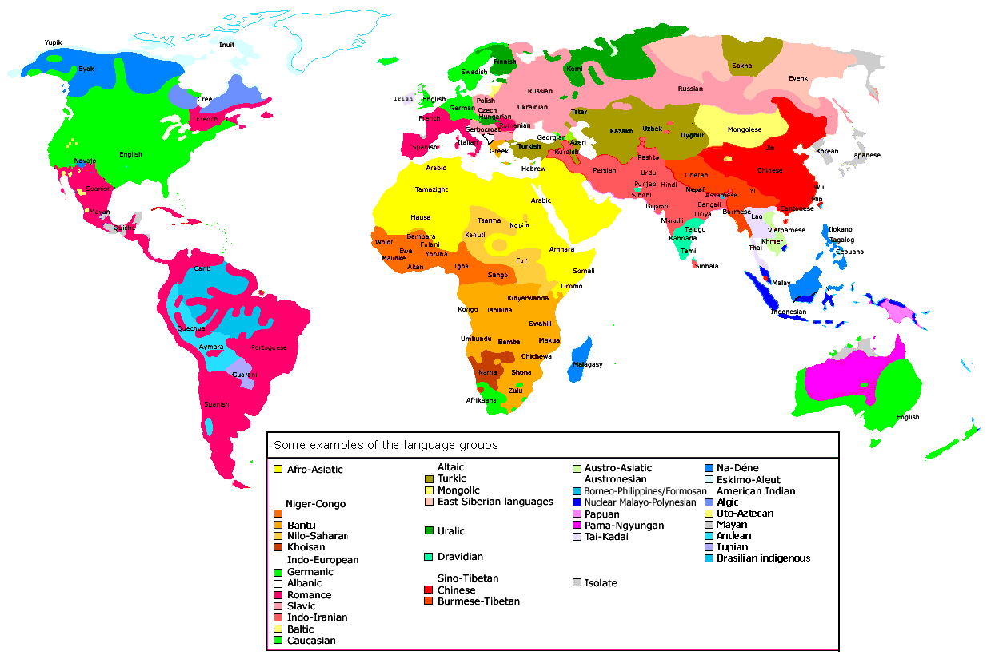

Slide 11
And then,
How did language originate?
We say Hindi and Panjabi are quite similar.
Is it accidental or is there some relation between these two languages?
Are languages related to each other?
Are all the languages related to each other? Or
Are there multiple 'stocks' ?
If multiple, then how many? If single, then where did it begin?
How have these languages diverged?
Why do languages chage over a period of time?
What are the ways in which languages can change over time?
Linguists are interested in all these questions and more!!!

Slide 12
Linguistics?!
Linguistics, therefore, is a study of 'Language' in all its
aspects
Linguistics as an area has a large number of sub areas under it.
a) A branch of linguistics looks at the structure of language:
  Syntagmatic and paradigmatic aspects of language structure,
  Levels of structural analysis
  Phonetics and Phonology (sound systems)
  Morphology (word structure)
  Lexicon (Dictionaries etc)
  Syntax (sentence structure)
  Semantics (looking at meaning in a sentenece)
  Pragmatics (how we use language)

Slide 13

This leads to questions such as!!
What is meant by 'structure' of language?
If it is a structure, then it must be composed of some units?
What are these units?
How can we identify these units?
How do we ensure that a given 'element' is a unit?
How are these units organized?

Slide 14
Linguistics : Different fields of study
b) From evolution perspective : Historical Linguistics
c) From usage perspective : Sociolinguistics
d) From Psychological perspective : Mechanisms of language acquisition, knowing more than one language etc
e) From neural perspective : Neurolinguistics
f) From cognitive perspective : Cognitive linguistics
g) From Computational perspective : Processing natural languages

Slide 15
Where all do we need linguistics?
Language teaching, particularly second language
Writing grammars
Developing dictionaries
Speech pathology
Brain damage cases
Natural language processing
Speech technology
This course will address some of the questions raised earlier
Primarily related to the structures in language
The course forms the foundation for CL/NLP

Slide 16
Computational Linguistics/Natural Language Processing
Advancing technology
Man – machine interaction
    Information search
    Information extraction (eg. opinion mining)
    Text summarization
    Dialogue systems
    Question answering
Man – Man interaction via Machine Translation (MT)
Speech technology
Talking machines
  Cars, mobile apps etc

Slide 17





Machine Translation
Text
speech
speech
Text
Applications:
Web document translations
Translators helpdesk
Mobile app

Slide 18


Dream Application
Telugu
Utterance
Automatic Speech
Recognition System
హైదరాబాదు నుంచి చెన్నై వెళ్ళడానికి ఎదైనా ఏరోప్లేను ఉందా ?
Telugu to Hindi
Machine Translation
System (domain-specific)
हैदराबाद से चेन्नै
जाने के लिए कोई फ्लाइट मिलेगी क्या ?
Hindi
Utterance
Text to Speech
System

Slide 19
This Course will study
The Structural aspects of language
  Sounds
  Words
  Sentences

Slide 20
Course Evaluation
Continuous evaluation
  Weekly assignments
  Project
  Exams
Weightage
  Assignments : 15
  Mid Sem : 30
  End Sem : 35
  Project : 20

